Slide 1
Talking NCD ’The Pacific Way’
Dr Viliami Puloka
Health Promotion Forum

Slide 2
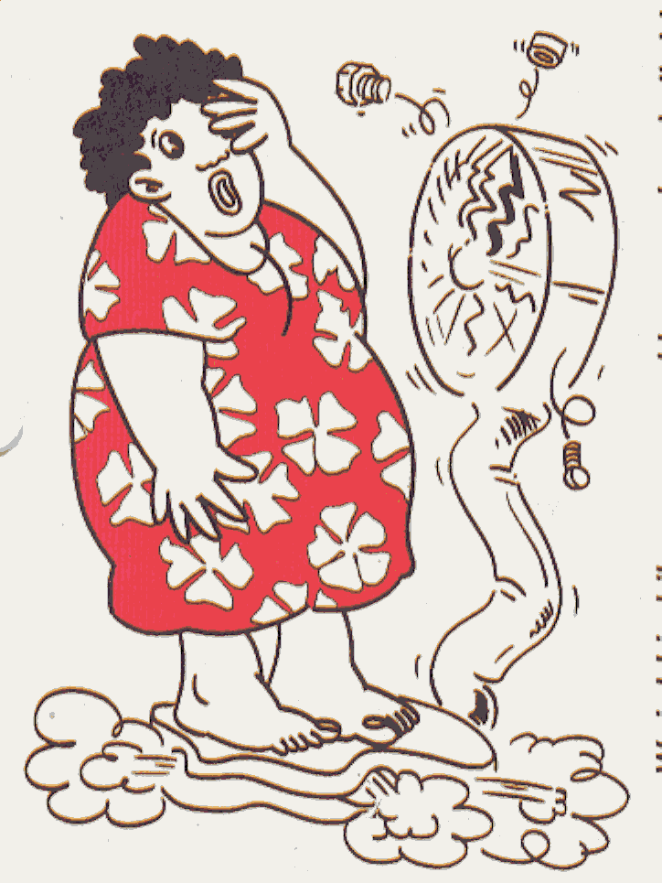
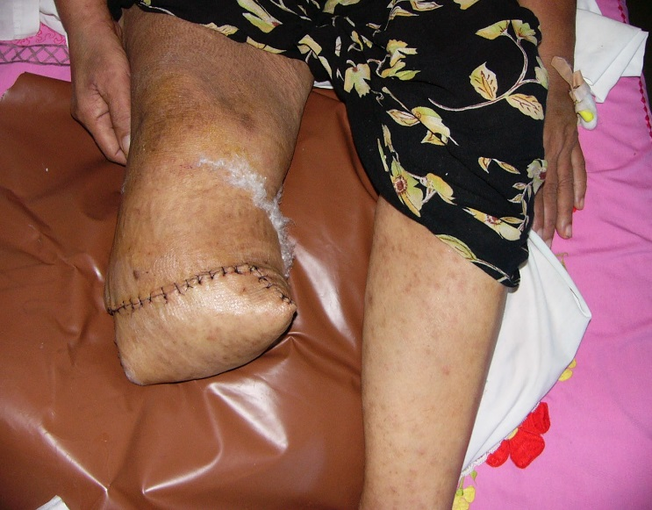
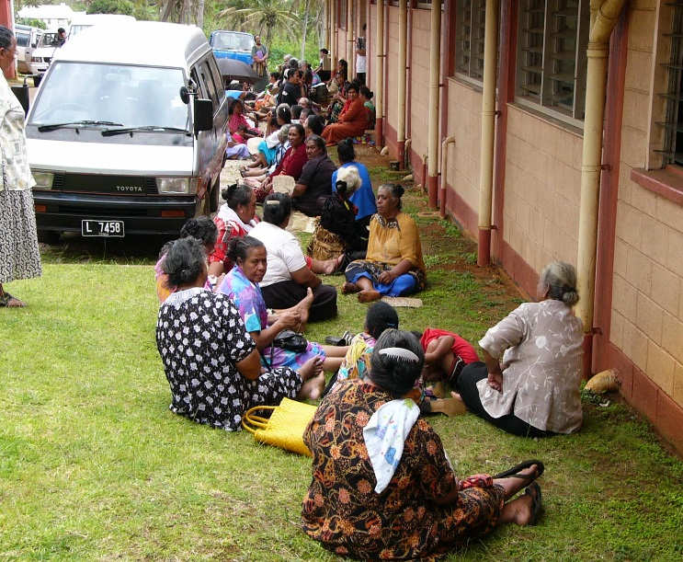
NCD
in the PACIFIC
Too BIG to Ignore
40% Sickness
57% Death
10-20% Health Cost
Development Issue
Labour supply
Productivity
Investment
Education
Notes:
NCD contributes the most to sickness, death and have the Lion’s share of health cost. Except for PNG, all PICTs have NCD as their number one burden of disease. In Tonga, Vanuatu and Kiribati NCDs account for 19.6%, 9% and
8.1%, respectively, of all treatment expenditures. To put this in context, in Tonga
for example, one out of every 10 (10.4%) patients admitted to hospital are
admitted for a NCD, however, for every 5 dollars spent on treating all patients, one
of these dollars (20%), is required to treat the patient with a NCD.
Doran (2003)

Slide 3
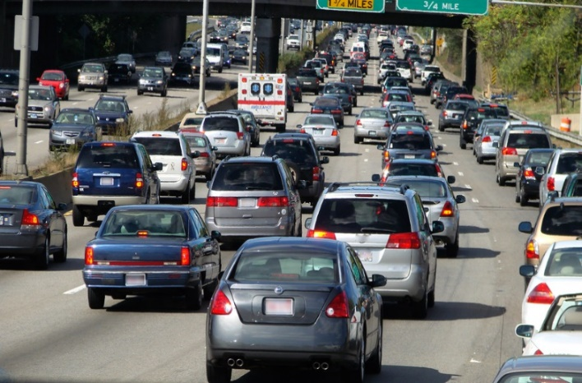
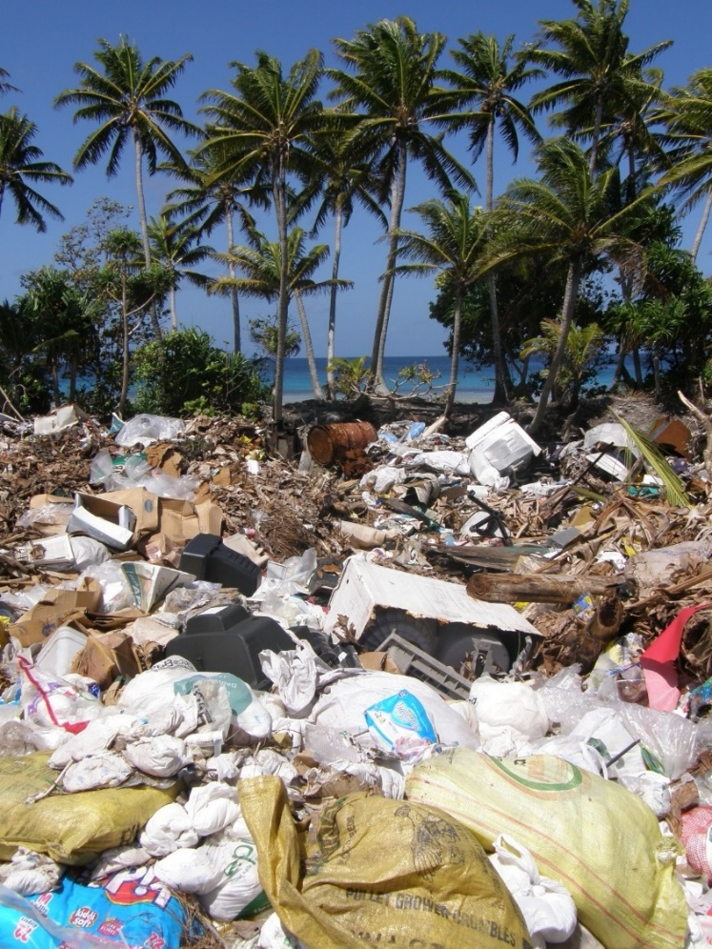
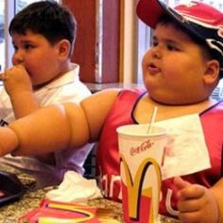
NCD?

Slide 4
What is Non-Communicable Disease?
Normal response
by
Normal people
to
Abnormal Environment

Slide 5
Dis-ease of Justice and Equity
Avoidable and unjust health inequities driven by lack of access to good nutrition, time and opportunities for physical activity, education, employment and secure housing drive this difference between the impact of NCDs in rich and poor communities.

Slide 6
Key findings of the New Zealand Health Survey 2011/12
Good news
Most adults (89%) report that they have excellent, very good or good health
except..
Groups with poorer health and more unmet need for health care included: Māori, Pacific, and adults living in more deprived areas

Slide 8
89% of all deaths each year in NZ are caused by NCDs
cardiovascular diseases,
cancer,
diabetes
chronic respiratory diseases
Mental illness

Slide 9
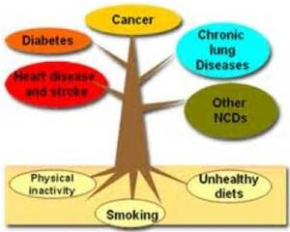
The NCD Big 4
Diabetes
Heart disease ( Cardio-vascular; CVA, Stroke)
Lung disease (Chronic respiratory disease; bronchiectasis , asthma)
Cancer
Heart Disease
And Stroke
Obesity
Alcohol

Slide 10
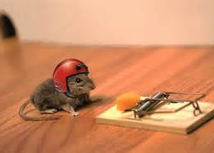
Risk Factors: Major 5
Smoking
Nutrition
Alcohol
Physical Activity
Obesity
SNAP-O!

Slide 11
Obesity

Slide 13
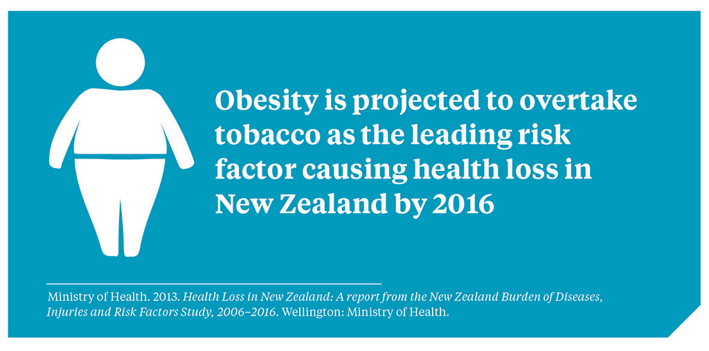
Obesity is the “New Tobacco”

Slide 14
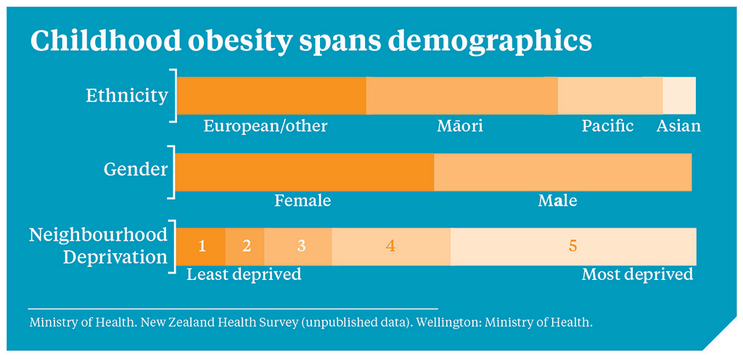
Early Start

Slide 15
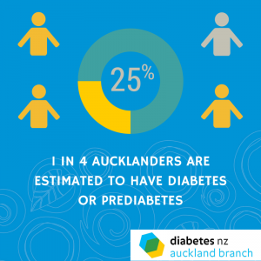
Diabetes

Slide 16
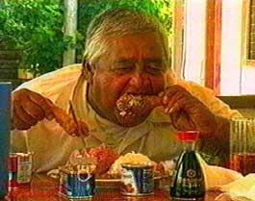
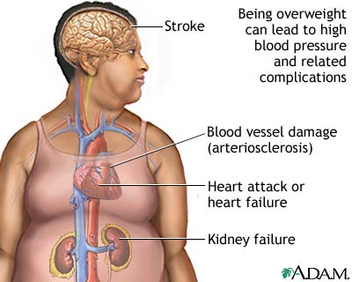
Social Determinants:
- Modernization
- Cash economy
Employments
Education
- ↓ Tradition and culture
Basic Risk Factors:
- Diet
-Physical inactivity
- Tobacco
-Alcohol
Intermediate Risks:
- High blood pressure
- High blood sugar
- Abnormal lipids
- Overweight
Diseases:
- Heart disease
-Stroke
-Cancer
- Diabetes
- COPD
Chain of Events
NCD -Determinants
Notes:
Non-communicable diseases can be traced back to their intermediate risks, basic risk factors and social determinants.

Slide 17
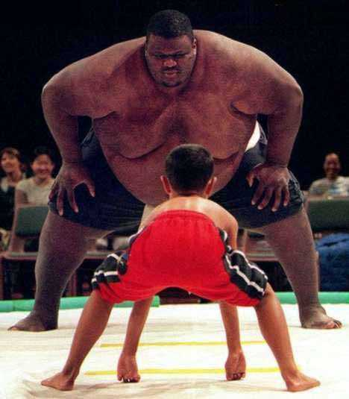
Health and wellbeing
…. Trade & Economic gain

Slide 18
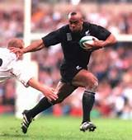
FOOD for Thoughts
“The way to a person’s heart is through the stomach “
Heart disease is the number 1 killer of Pacific people
BIG is Beautiful
FAT is NOT

Slide 19
KIA ORA
Thank you Merci Fa’a fetai Si yuus maase Ghilisou Meitaki maata Kalangan Kulo Kilisou Kammagar Vinaka Dhanyabad Mauru’uru Si yu’os ma’asi Mahalo Ko bati n rabwa Kommol tata Tubwa kor Fakaaue lahi Sulang Tenk yu Tanggio tumas Fakafeta’i Malo

